Slide 1
Game Plan
Driving Organisational Enhancement
Prepared by Steve Marquis
16 February 2024

Slide 2
Game Plan Overview
Club and Peak bodies

Slide 3
Game Plan
Capability Assessments
Deliver sector wide capability assessment content that can be tailored and filtered to support State Sporting Organisations.
Consistent development across all levels of the sector.
Action Plans
Simple Action Plans to support ongoing organisational enhancement projects using data to support and guide decision making.
Resources
Connect organisations to national and state specific resources to support Action Plans.
Resources to include policy release, general resources, eLearning, webinars and podcasts.
Data and Reporting
Access to and analysis of data gathered through Game Plan.
Reporting to be specific to each organisation as well as data from clubs specific to each state and sport. This helps build organisation analysis as well as support to club stakeholders.

Slide 4
Game Plan Overview
Game Plan for Clubs
Tailored to the club user
Game Plan allows clubs to build their profile and set their priorities to tailor the experience to them, enabling club leaders to focus on high priority modules.
Sport Customisation
24 NSOs have done some customisation in Game Plan to ensure images and questions connect with club users. There are further sports in the pipeline.
Over 3900 Clubs registered
Game Plan for Clubs was launched in December 2020. Since then there have been over 3900 Clubs registered and started their capability building journey.
Capability Building Focus
Identifying current maturity across modules helps identify areas of need in relation to organisation capability. Building plans with relevant resources sets clubs on a positive path forward.

Slide 5
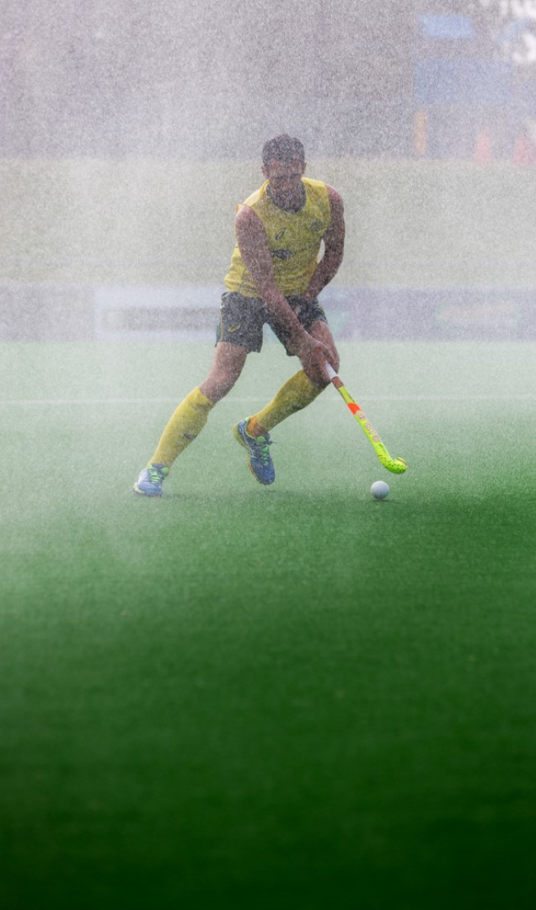
Game Plan Overview
100%
Game Plan for Peak bodies
Sport Governance Standards
With the transition to Game Plan for the Sports Governance Standards Survey, 100% of funded NSO/Ds submitted their annual response.
With a focus on supporting capability building at all layers of the sector, Game Plan for NSO/Ds was launched in April 2023. Utilising the existing Sports Governance Standards and associated GOE Planning process we were able to enhance the process through the use of Game Plan.
Utilising key automation features SGS assessments were complete, approved by board chairs and use sport tiering to populate expected scores, suggested activities in action plans and generate reports to drive analysis and action.
With this process successfully implemented, tested and user familiarity, we can now launch future modules to focus on key organisational modules relevant to each layer of the sector. The Finance module is scheduled for deployment October 2023.
Utilising data to support other factors and indicators highlights opportunities to address areas of greatest need and impact in enhancing the delivery of sport.
Action
GOE Planning
An activity based Action Plan has supported the GOE Planning process. Feedback from CEOs indicated the process was simple, intuitive and a positive experience.

Slide 6
Capability Building
Capabilty vs Performance
Capability is the organisation and broader sport system’s ability to delivery in key areas of sport delivery.
Building capability helps increase the ability to provide structure, support and delivery of key elements of operations.
Some elements are led by internal drivers and leading a sustainable sport while others are driven by broader goals of participation, community engagement and competition.
Performance is an indicator of how well these capabilities are actioned and implemented to meet strategic and operational goals.
Ongoing links between Capability and Performance
Capability modules will focus on the systems, structures and processes to support success in each module area.
Organisation capability will support the capability framework developed in a consistent way across all levels of the sector. Roles and responsibilities of each layer will be considered when tailoring module content.
Organisation performance can be measured to evaluate the effective implementation and delivery utilising the organisation capabilities.
Performance will be measured outside of the the capability modules with both sets of data referenced in identifiying organisation growth and the impacts/outputs.
Performance may include areas of financial growth, governance improvement as well as participation growth, high performance success, etc.
Module development pathway
Ongoing review of existing modules
Alignment of key strategies – HP2032+, PlayWell Strategy, etc
Sector demand
Alignment in modules across levels – national, state, club

Slide 7
Game Plan
Overview for Peak Bodies

Slide 8
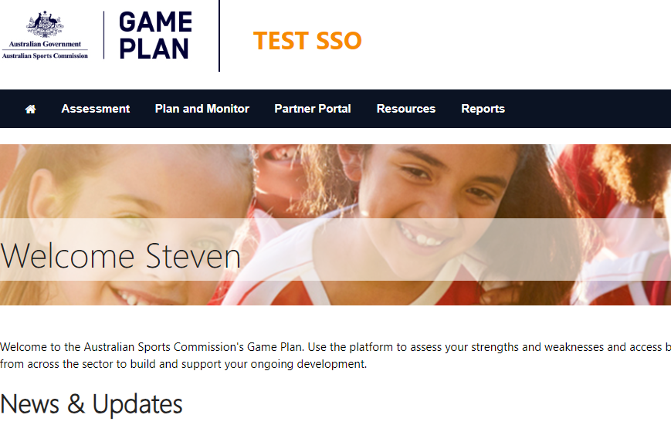
Getting started in Game Plan

Slide 9
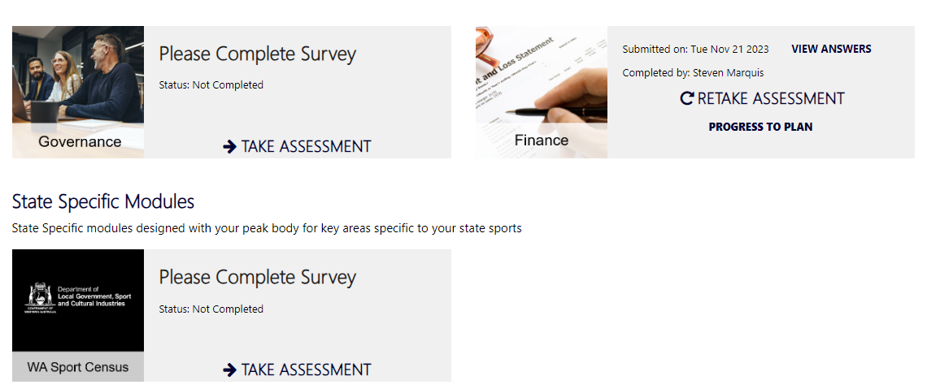
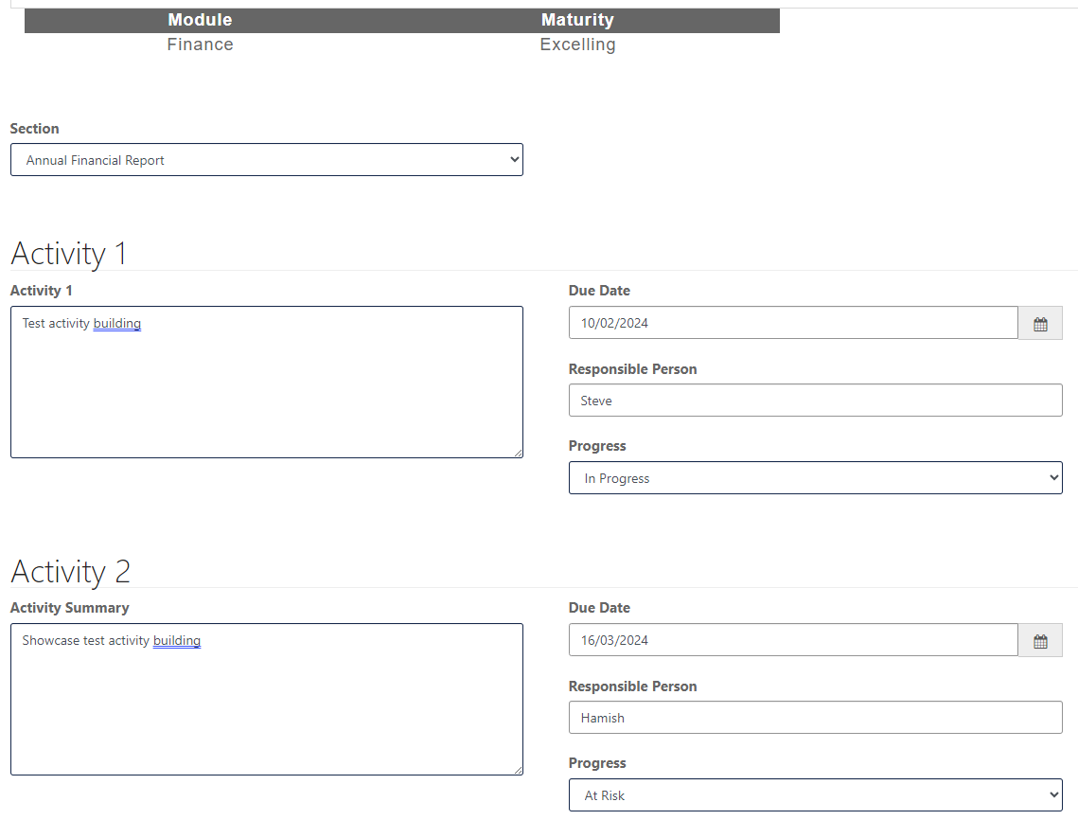
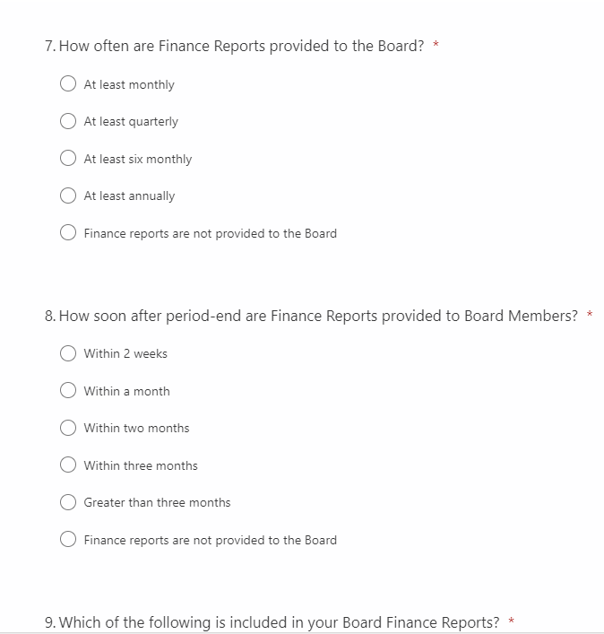
Organisation capability assessment and planning

Slide 10
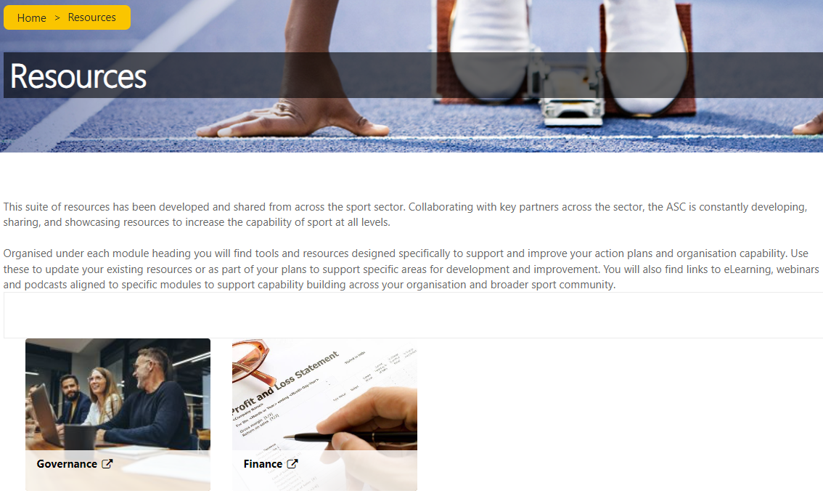
Resources
Sector wide, state and sport specific

Slide 11
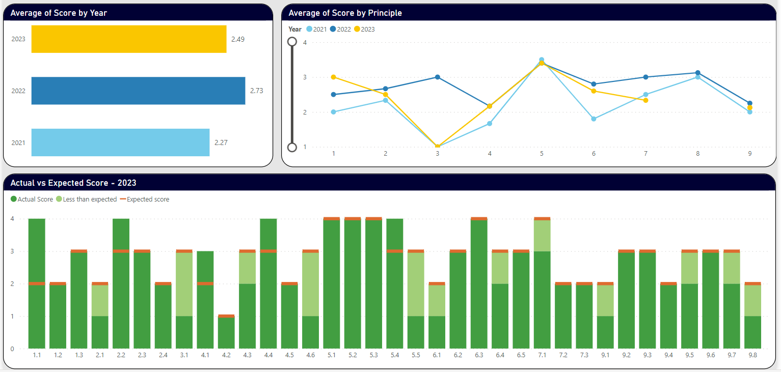
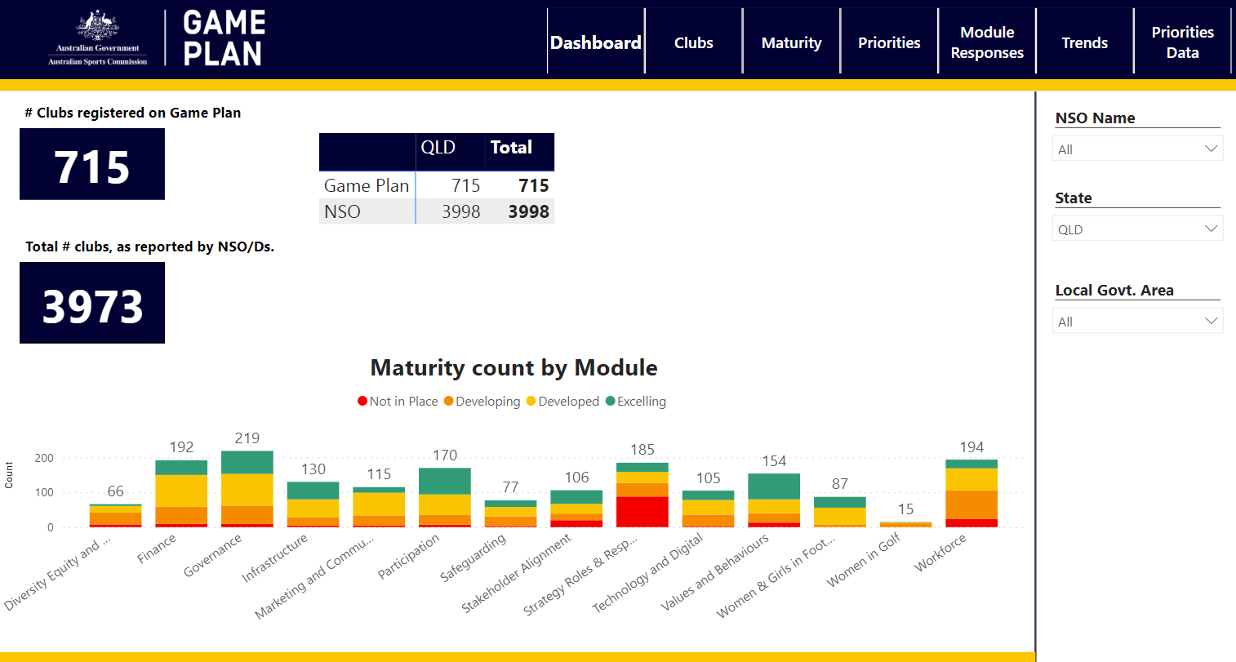
Data to support development, decision making and planning

Slide 12
Game Plan
Overview for Clubs

Slide 13
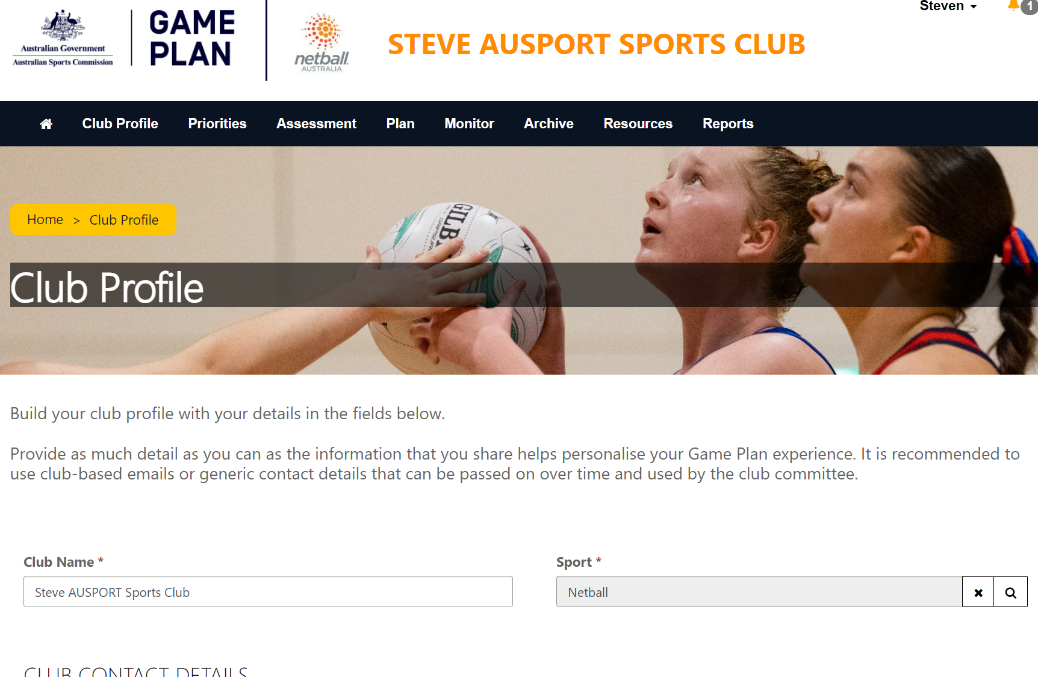
Getting started in Game Plan

Slide 14
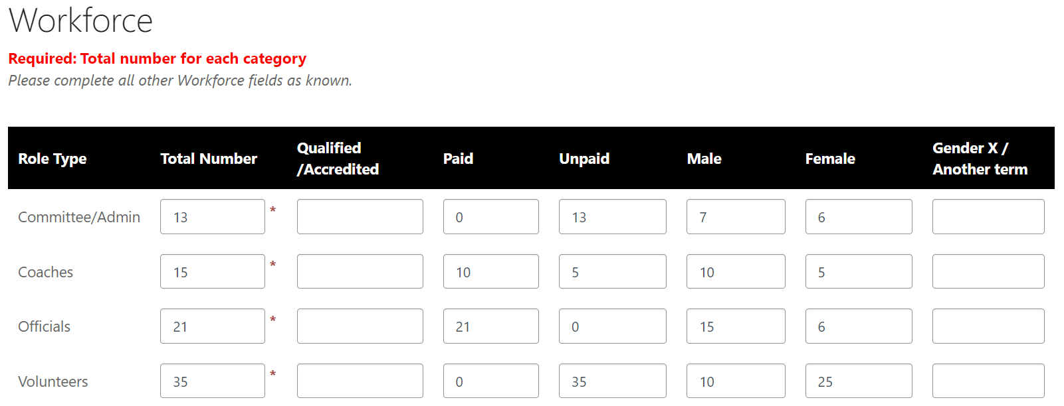
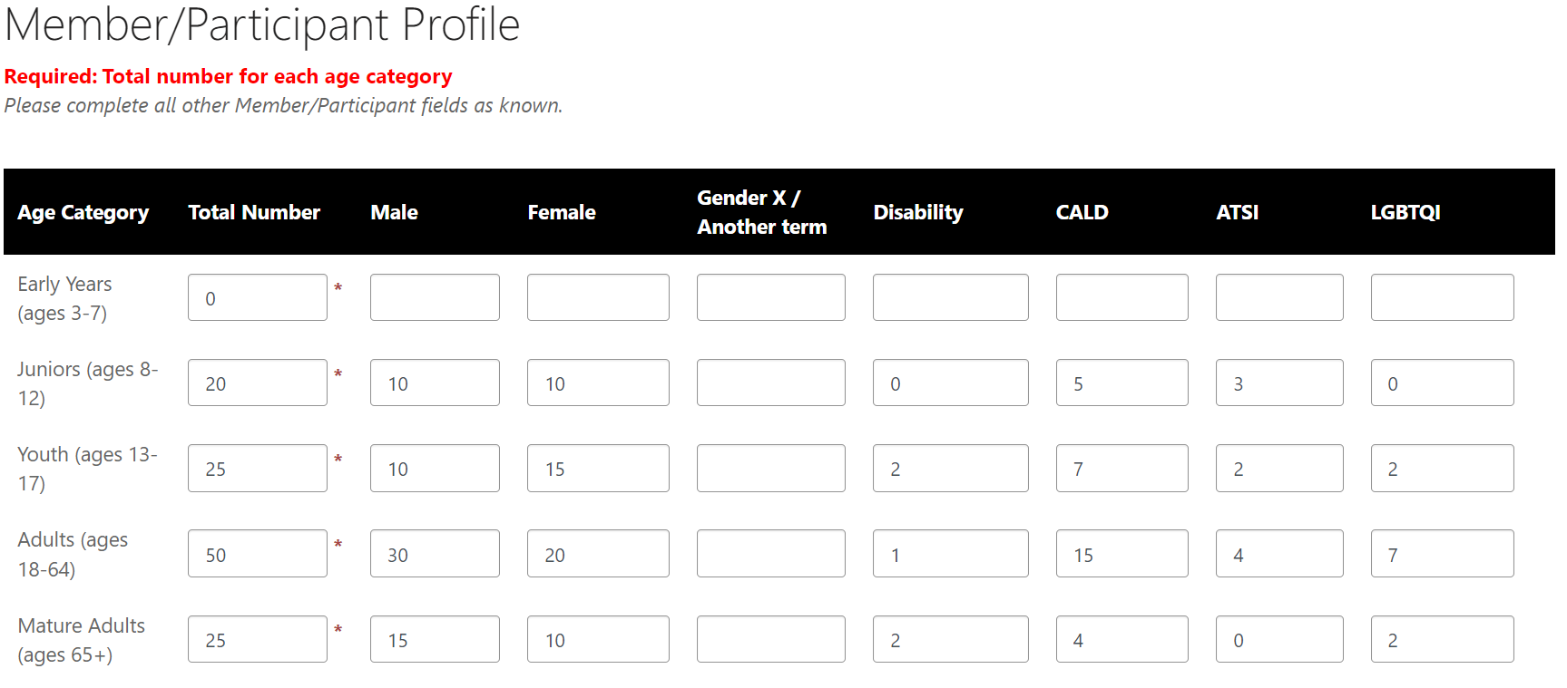
Club Profile data
Currently data:
- 36,942 Committee/Administration
- 70,317 Coaches
- 18,498 Officials
- 51,204 Volunteers
Over 503,000 participants

Slide 15
Club Priorities
What are your sport priorities?
How are you influencing and collaborating with your stakeholders?
What do you think are the leading club priorities?

Slide 16
Priorities across clubs

Slide 17
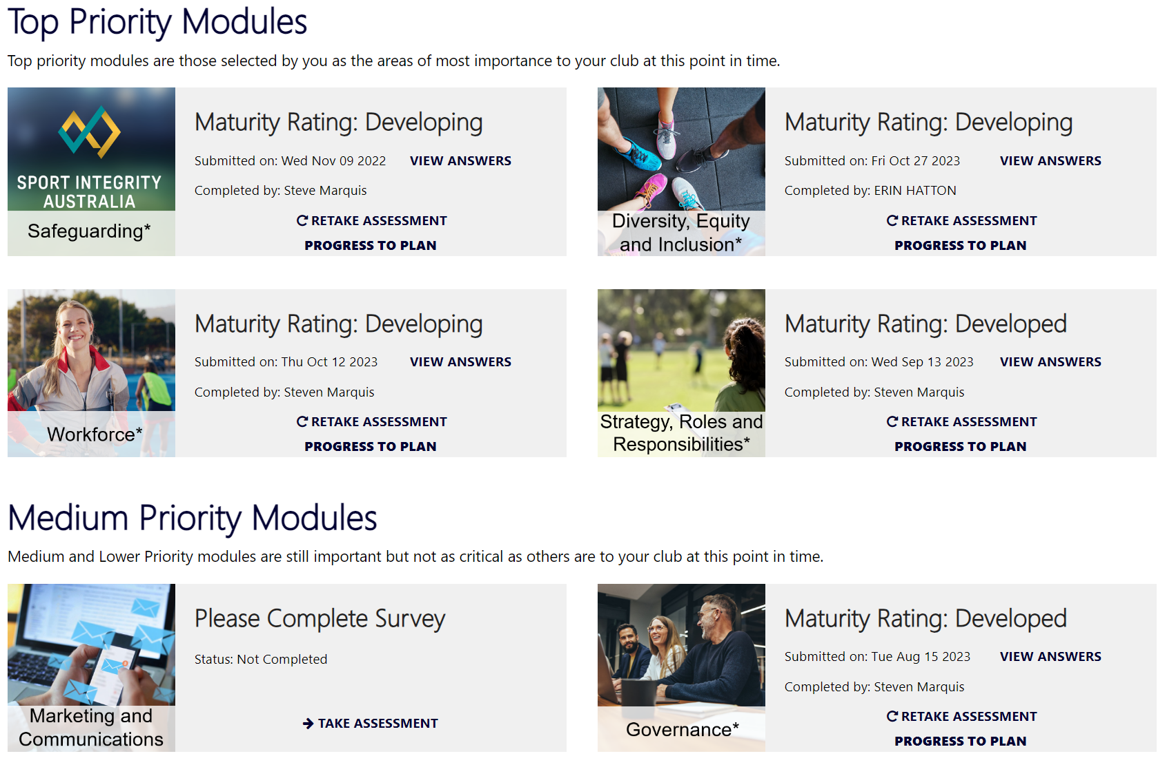
Capability Building
Self-Assessment
Modules ordered to align with set priorities
Modules are short with time commitment up to a maximum of 15 minutes
Best practice is to complete as a group to ensure balance of response
Widgets update to enable module maturity rating, answers to be viewed and progression to building action plans

Slide 18
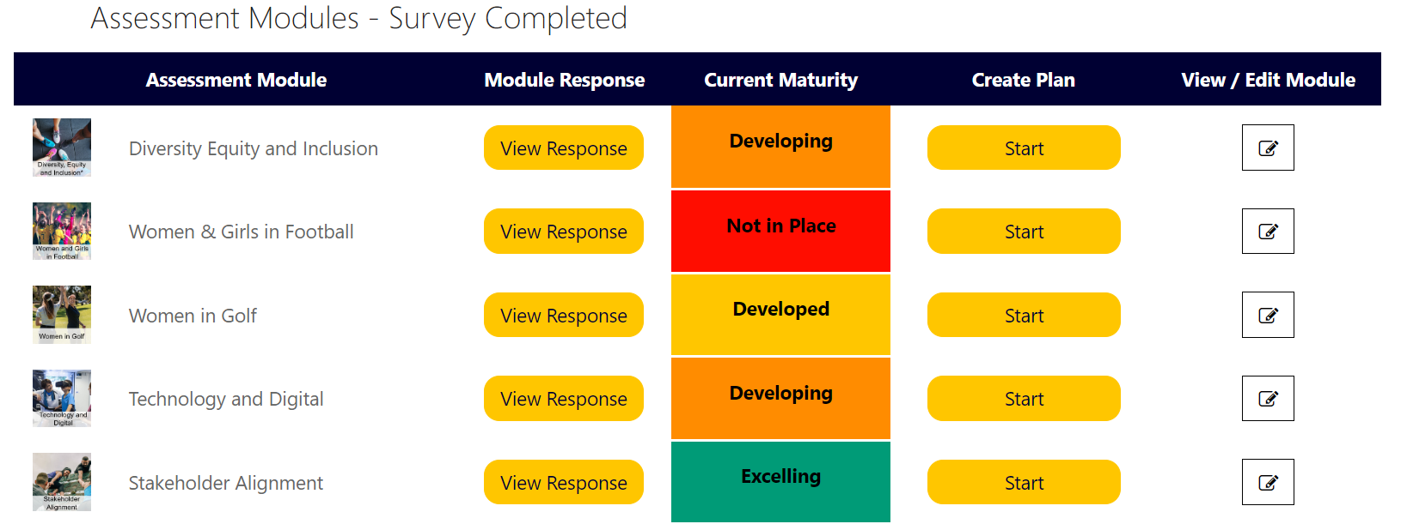
Action Planning
Results leading to action

Slide 19
Resources
Sector wide, state and sport specific

Slide 20
Rugby Australia: Game Plan
Participation Leaders Network
February 20, 2024

Slide 21
The Golden Decade

Slide 22
Why is Club Development Important?
Build Capability |  | Build Capacity |  | Safe, Inclusive Environments |  | Positive Experiences
Improve performance in:
Governance
Finance
Strategy
Operations
Recruit and retain participants
Recruit and retain volunteers
Facility and infrastructure planning
Promote and support social connectedness, safety, and wellbeing of participants
Support participants to form meaningful, lasting connections with their community and sport
Future Proof Clubs and the Sport

Slide 23
National Club Development Strategy
Drive investment, resourcing, intervention, and support across national network with consideration to:
Priority regions, associations, and clubs
Participation trends and population forecasts
Localised opportunities
39

Slide 24
Club and Association Support
Identify Priority Clubs |  | Initial Meeting and Assessment |  | Game Plan and Intervention |  | Ongoing Support Package
Informed by Member Union strategic priorities
Includes assessment of governance, strategy, and operations
Includes governance and strategy development / intervention
Based on individual needs, priorities, and performance

Slide 25
National Club Development Standards
Minimum legal and operating standards e.g. governance, financial, safeguarding
Foundation modules completed (Game Plan)
Meets minimum standards but still has potential to improve
Foundation and priority module completed (Game Plan)
Demonstrated evidence of strategy and sound operations e.g. annual budgeting, operational plan
Best practice organisation
All modules completed and reassessed (Game Plan)
Legally compliant and excelling in club development and future planning e.g. strategic plan, D&I action plan, volunteer recruitment & retention plans

Slide 26
Key Performance Indicators
#
#
%
%
Clubs & Associations Engaged |  | Game Plan Submissions and Progression |  | Long Term Participation Growth |  | Improved Participant and Volunteer Experience
Per CDO
Combined

Slide 27
Game Plan data
Analysis, Consultation and Support

Slide 29
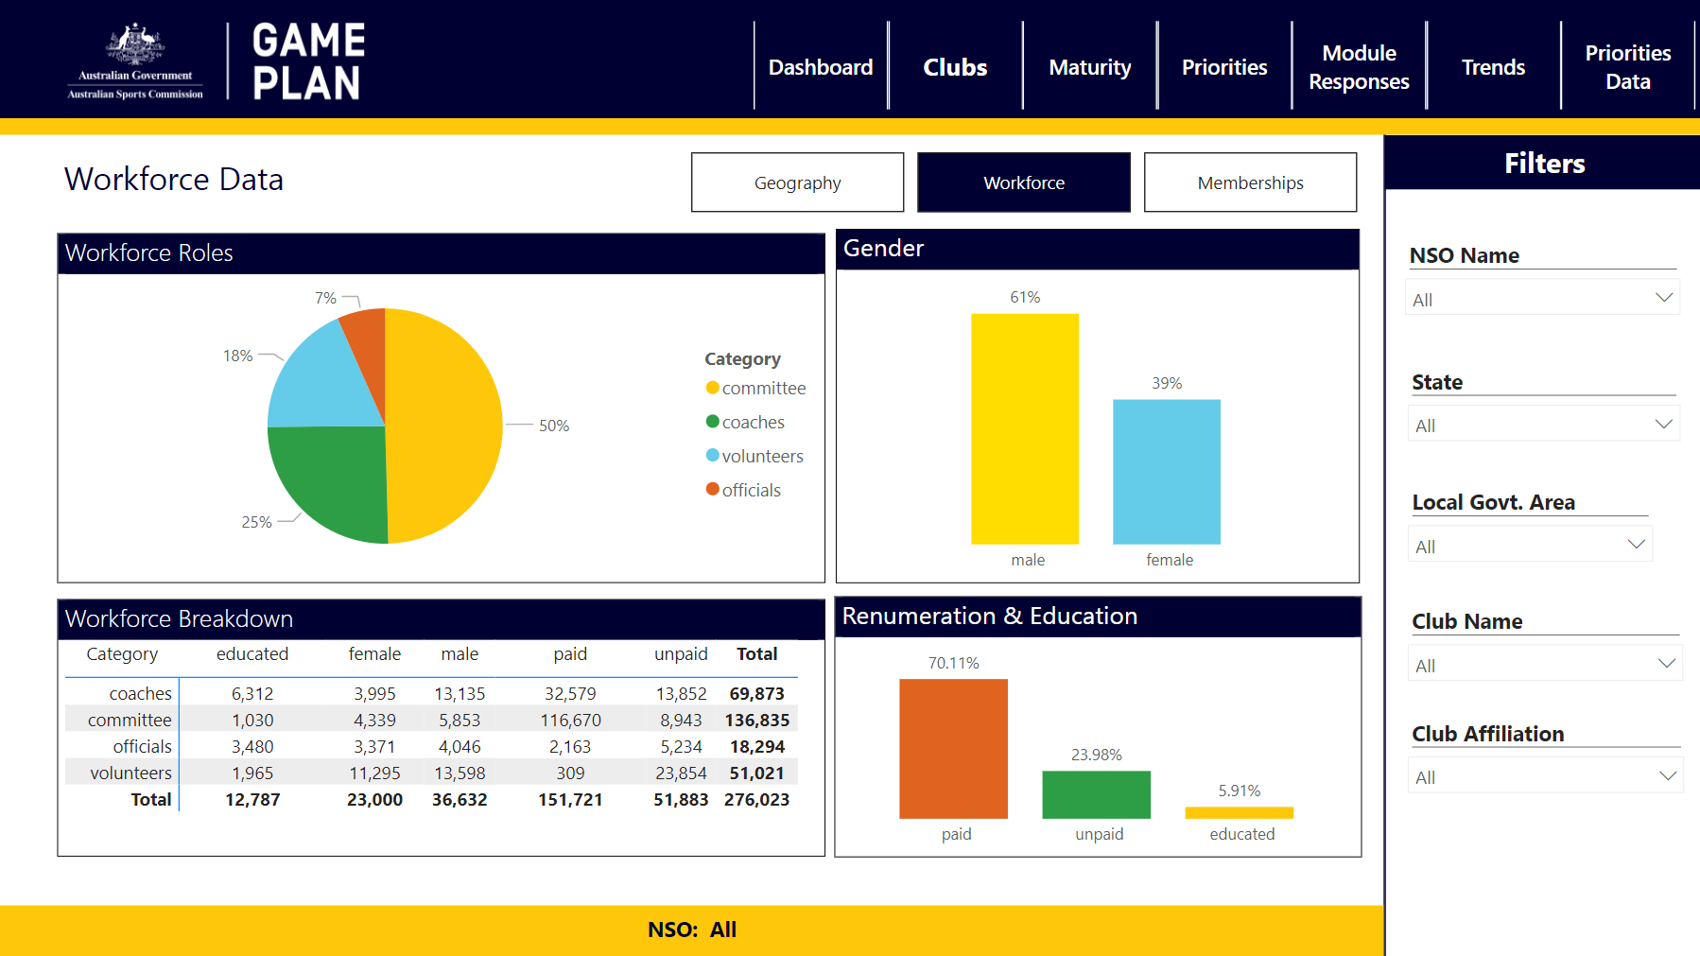

Slide 30
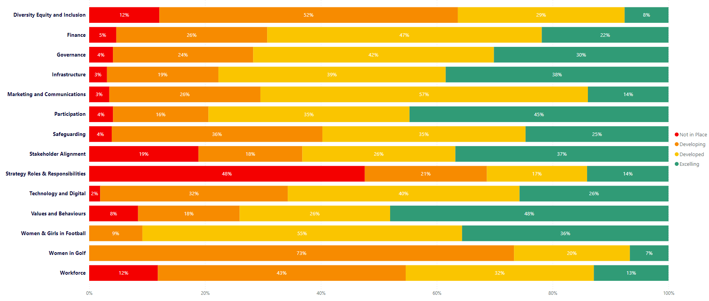
Module maturity

Slide 31
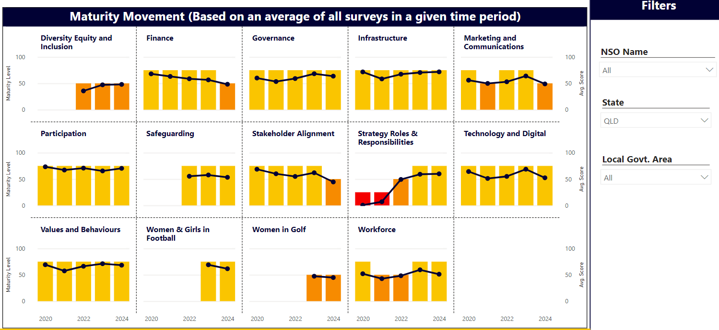
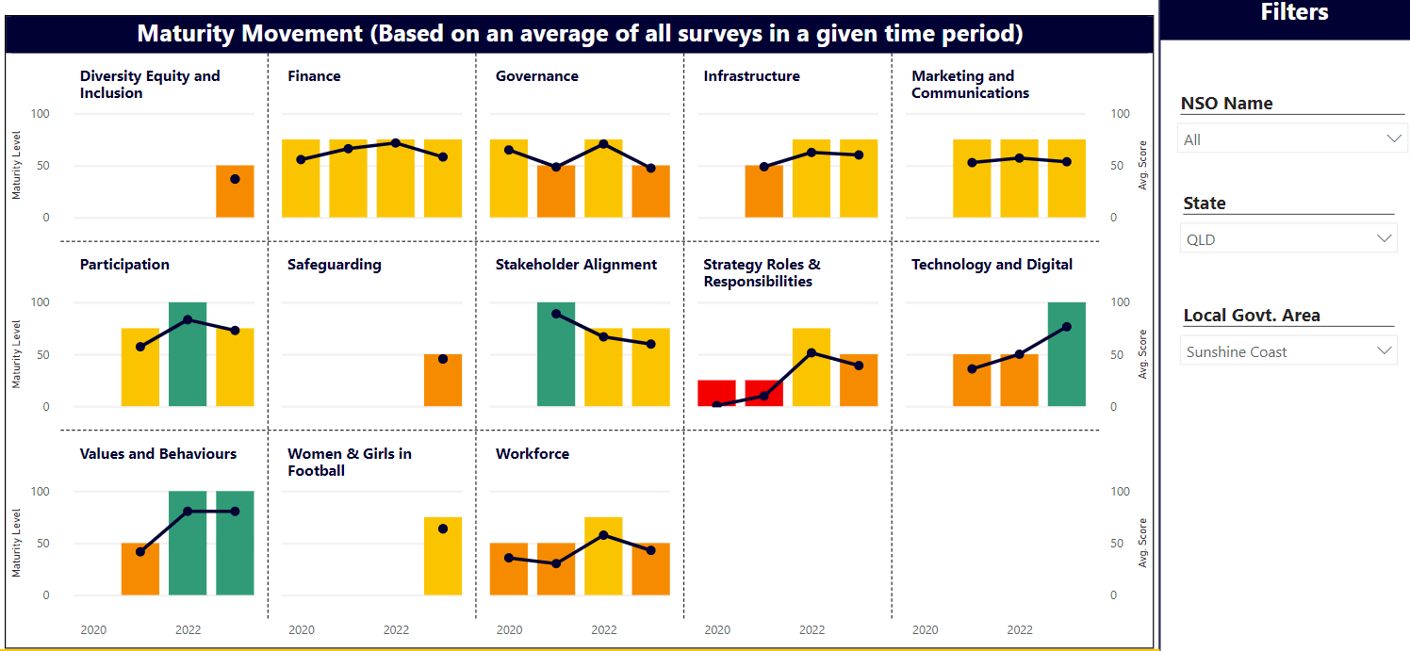
Tracking trends over time

Slide 32
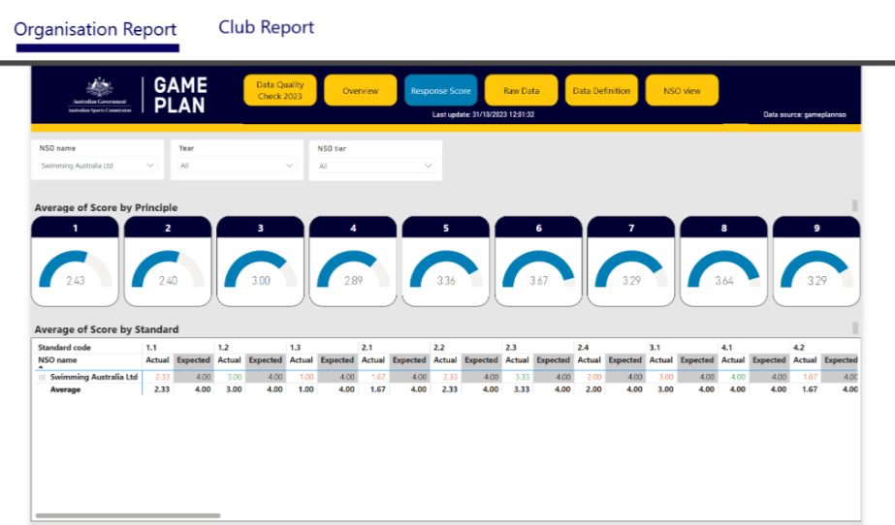
Organisation data for Peak bodies
Internal capability building and stakeholder support

Slide 33
BASEBALL WA
Club / association planning using “Game Plan”

Slide 34
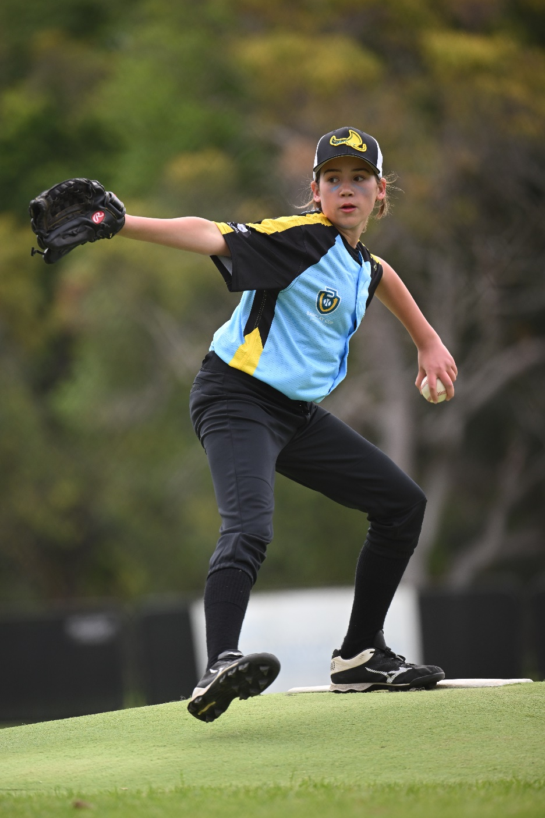
WHAT IS REALITY
most clubs do not have a Strategic Plan
a majority of clubs do not do planning of any kind with a focus on the operations
clubs tend to have issues with volunteer recruitment
clubs tend to have issues with committee succession, in particular committee members with higher level planning skill.
even when given the tools to do rudimentary planning, most clubs do not.

Slide 35
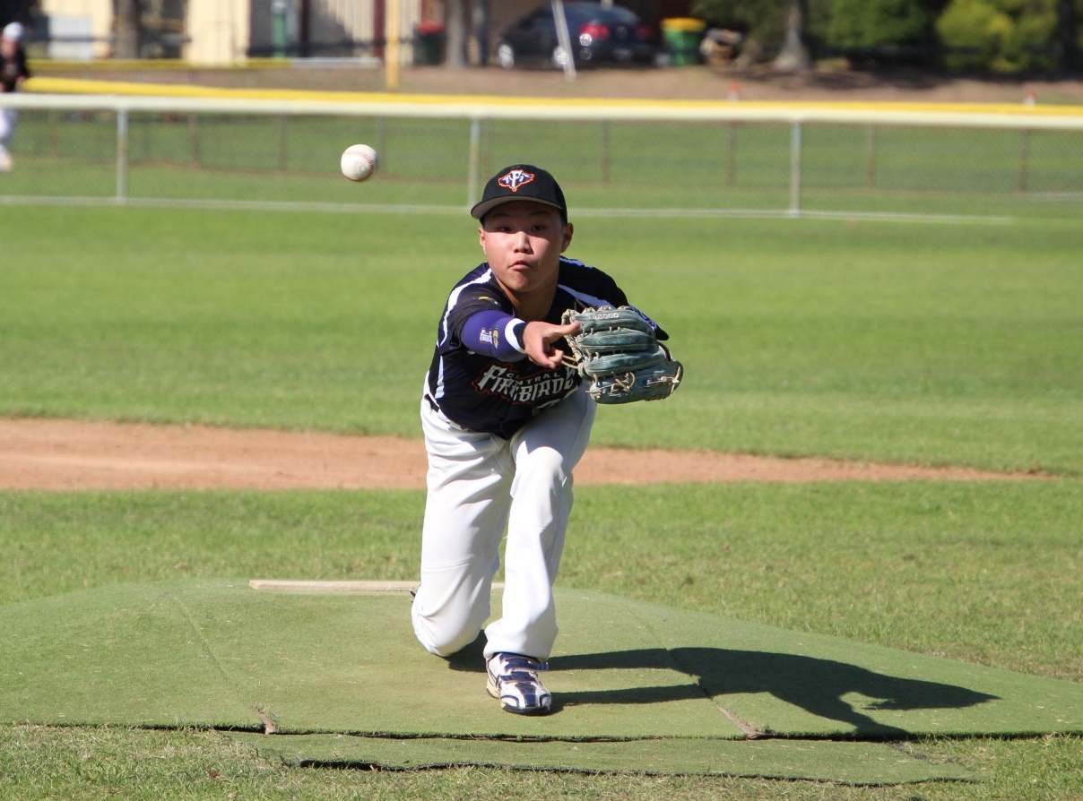
WHY IS THIS HAPPENING
Lack of committee expertise.
Committee members feel they are "time poor".
What is being asked of volunteers and committee members is unclear and typically undocumented.
"Strategic Planning" feels daunting and very often is outside of the typical committee person's comfort zone.
External consultants brought in to assist with strategic planning produce high level and complex documents that are never used.

Slide 36
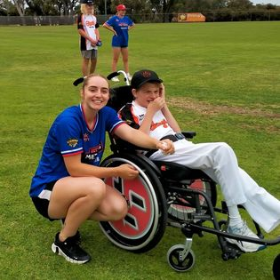
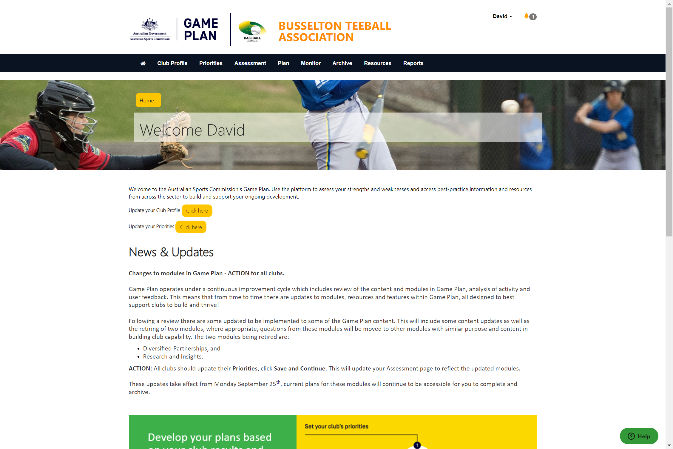
HOW ARE WE USiNG GAME PLAN
SSO is a partner to our clubs in using Game Plan.
Participation Manager is added as a Super User.
Clubs are engaged through face-to-face workshops and on-line Teams "quick catch ups".

Slide 37
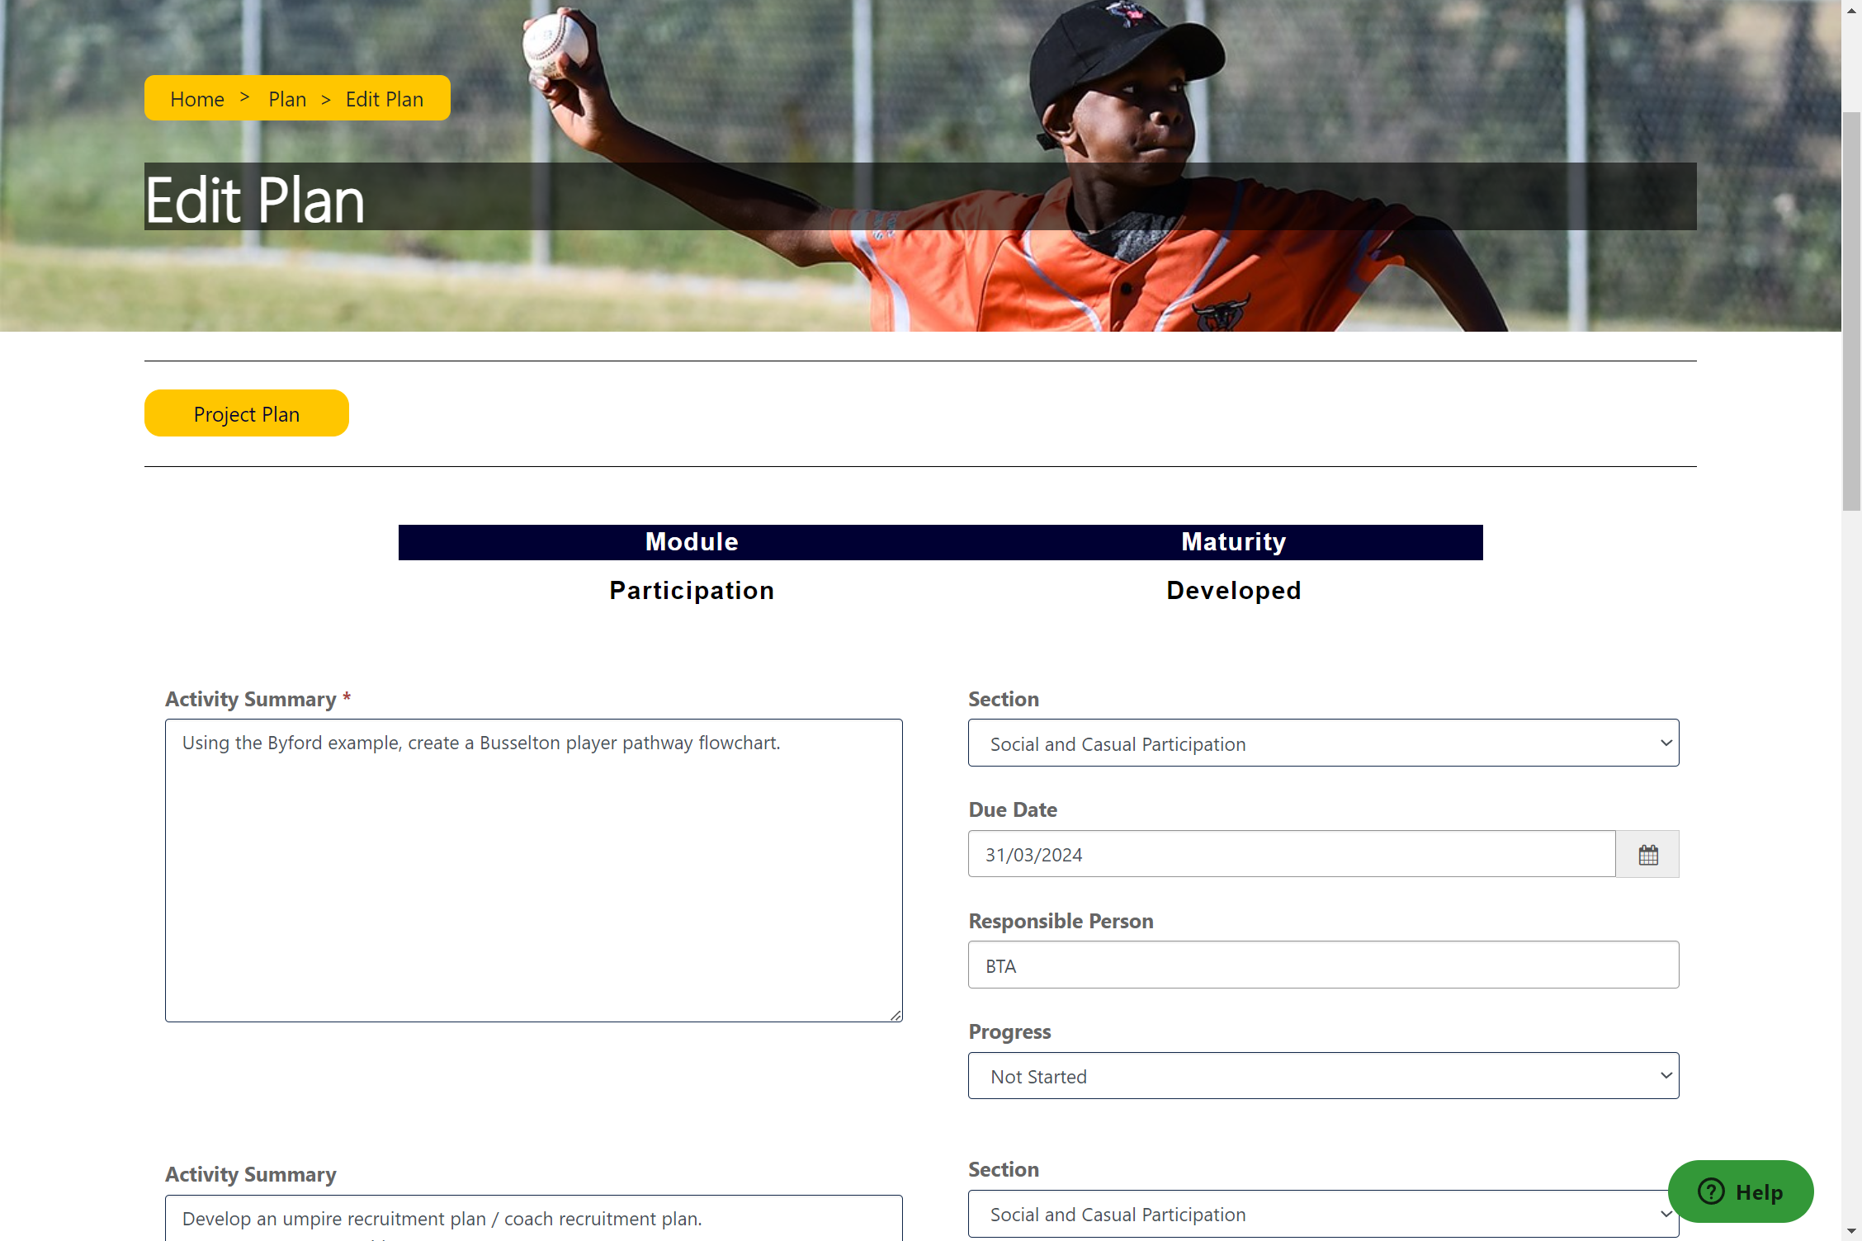
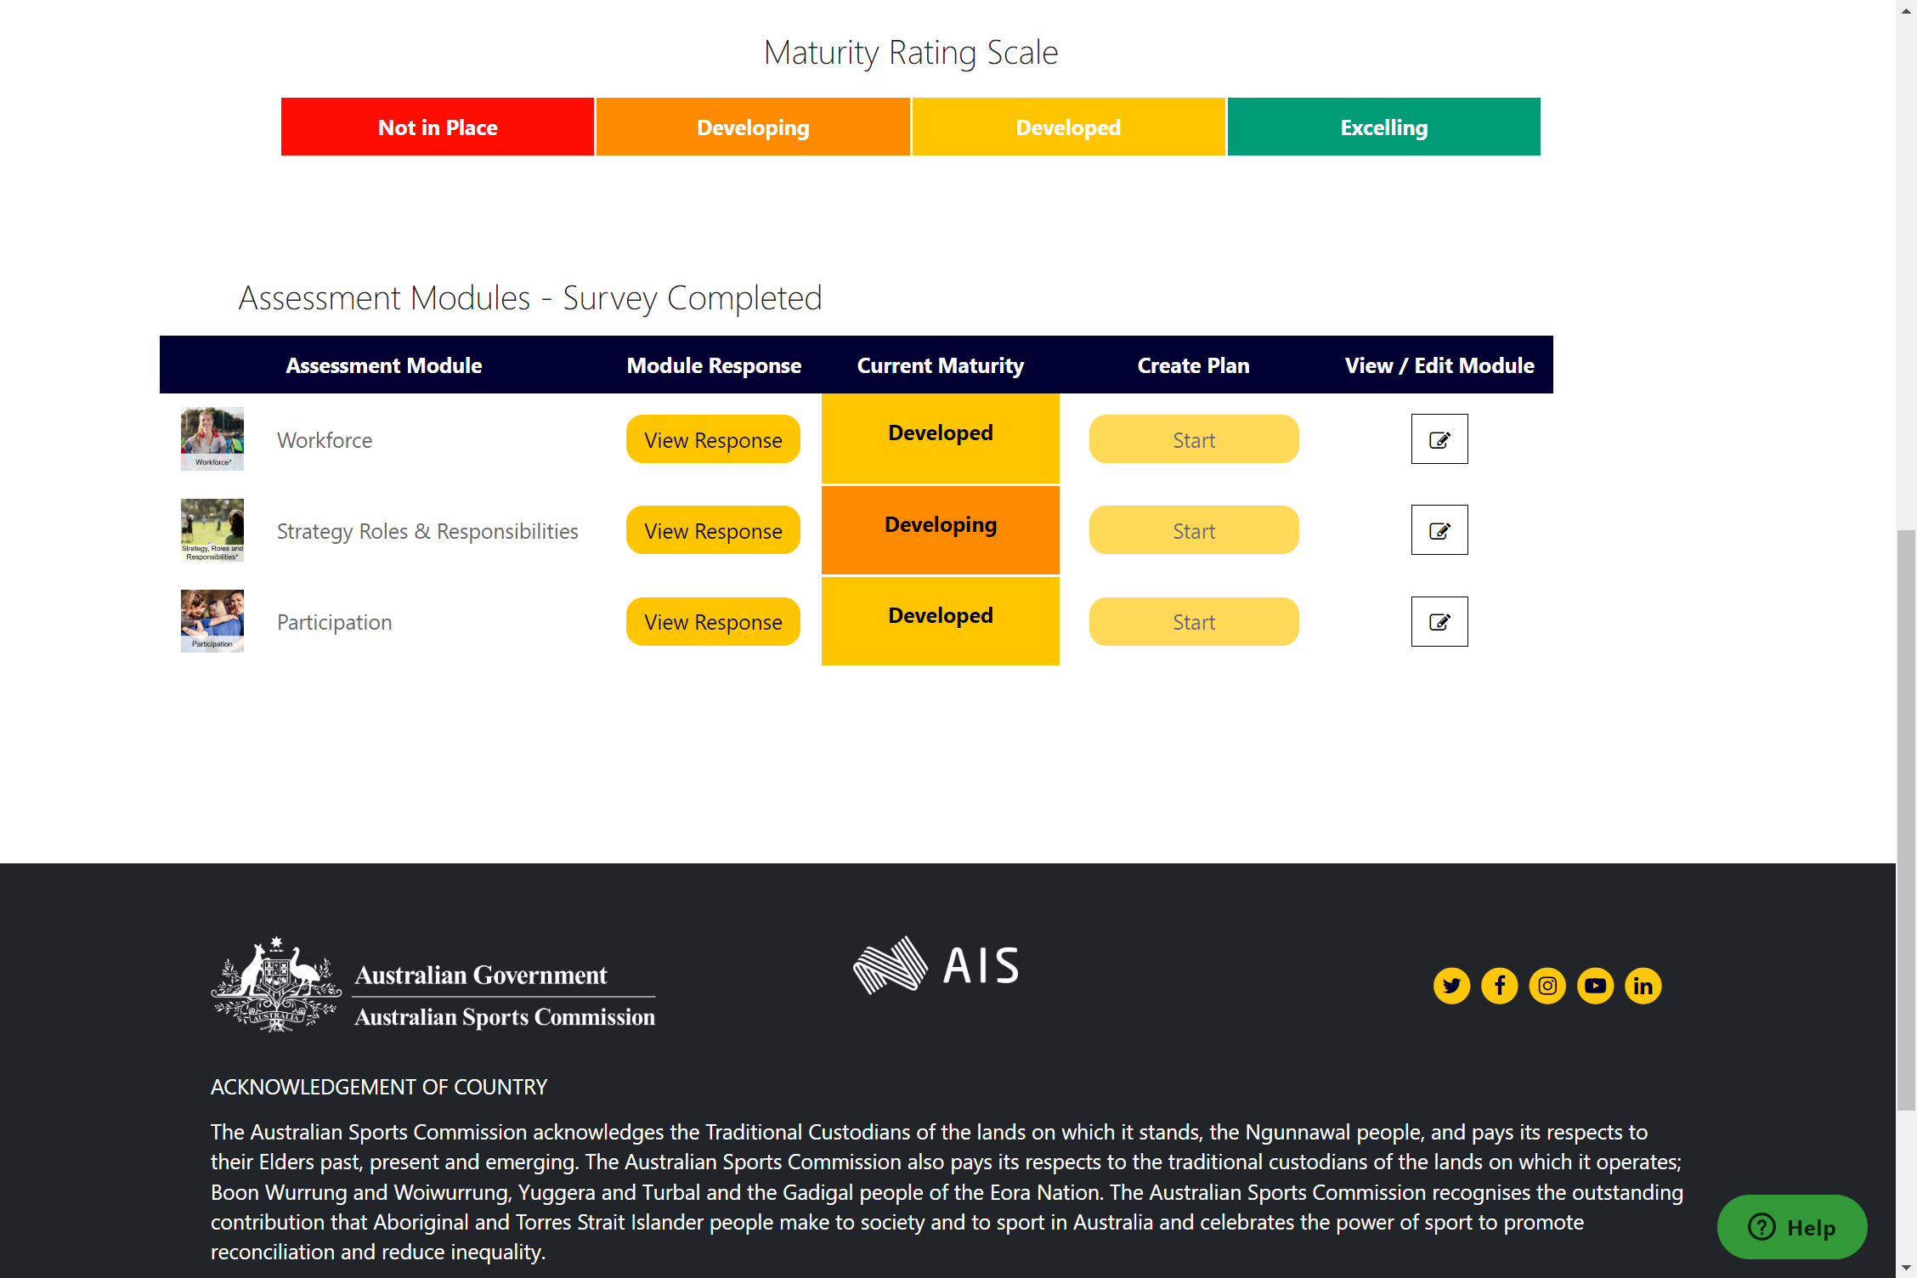
RESULTS
Workshops provide a forum for clubs to focus on planning rather than operations
Inclusion of LGA's and SSO's in the workshop process links clubs to their immediate partners/support who are as engaged in the club's success as the committee is
Clubs get to have proper discussions and work out what is important to their future success
Clubs are more focussed on the things that are important, not just what's operationally in front of them
Activity Plans provide focus and simplicity - what needs to be done, by whom and by when
Assessments provide a way of measuring success
Quick Catch Ups provide accountability

Slide 38
Game Plan
Supporting the sector

Slide 39
Connecting the layers of support
Organisation capability assessments and plans
Sports Governance Standards assessment to be launched by April, final date TBC.
Finance module in place for assessment and plan building.
Monitor and track your plans as you progress throughout the year.
New modules to be released based on Organisation Capabililty Framework.
Connecting with the layers of Government
Utilising data can support the discussion with key stakeholders at all layers of Government.
ASC support, resources and discussions should include the insights from module assessments at organisation level as well as broader sport network.
State Government review and support organisations within each jurisdiction. The state specific data allows a narrowing of focus, stakeholder support and targeted support.
Local Government are a significant supporter at community level. Connecting sport staff with local government staff can help support club development, infrastructure planning and give good insights into the diversity of community needs.
Supporting your club network
Review your club data
Consider an approach to encourage clubs to be active in Game Plan. Focus on particular modules supports initial engagement.
Work with your State and Local Government partners to support the network and grow club success in your sport.
Consider any additional resources for clubs to access through Game Plan.

Slide 40
Further information Steve Marquis steven.marquis@ausport.gov.au
ausport.gov.au
Leverrier Street Bruce ACT 2617 PO Box 176 Belconnen ACT 2616 +61 2 6214 1111

